Slide 1




Enhanced Solution Phase Close-Out Brief
X-Ray Simulators for Test and Evaluation of Nuclear Survivability
(XSTENS)
Distribution Statement C – Distribution authorized to U.S. Government agencies and their contractors: Critical Technology, Specific Authority 2 July 2019. Other requests for this document shall be referred to Defense Threat Reduction Agency, 8725 John J. Kingman Road, Fort Belvoir, VA 22060-6201.
Heather Jiles
DTRA RD
571-616-5533
E-mail: Heather.L.Jiles.civ@mail.mil
WARNING – ITAR MATERIAL – SUBJECT TO EXPORT CONTROL LAWS. The document contains technical data whose export is restricted by the Arms Export Control Act (Title 22 U.S.C. Sec 2751, et seq.) or the Export Administration Act of 1979, as amended (Title 50 U.S.C. App. 2401, et seq.). Violators of these export laws are subject to severe criminal penalties. Disseminate in accordance with provisions of DoD Directive 5230.25.
This document contains information that may be exempt from mandatory disclosure under the FOIA.
Joint Improvement and Modernization (JIM)

Slide 2
Outline
Project Summary
ESP Budget and Activities
Risk Reduction Activities
Use Case Development
Detailed Test Scenario with Re-entry vehicle
TCRD Status
WBS-Based Budget and Schedule
Summary of Risks
Phase 0 Planning
Summary & Recommendation

Slide 3
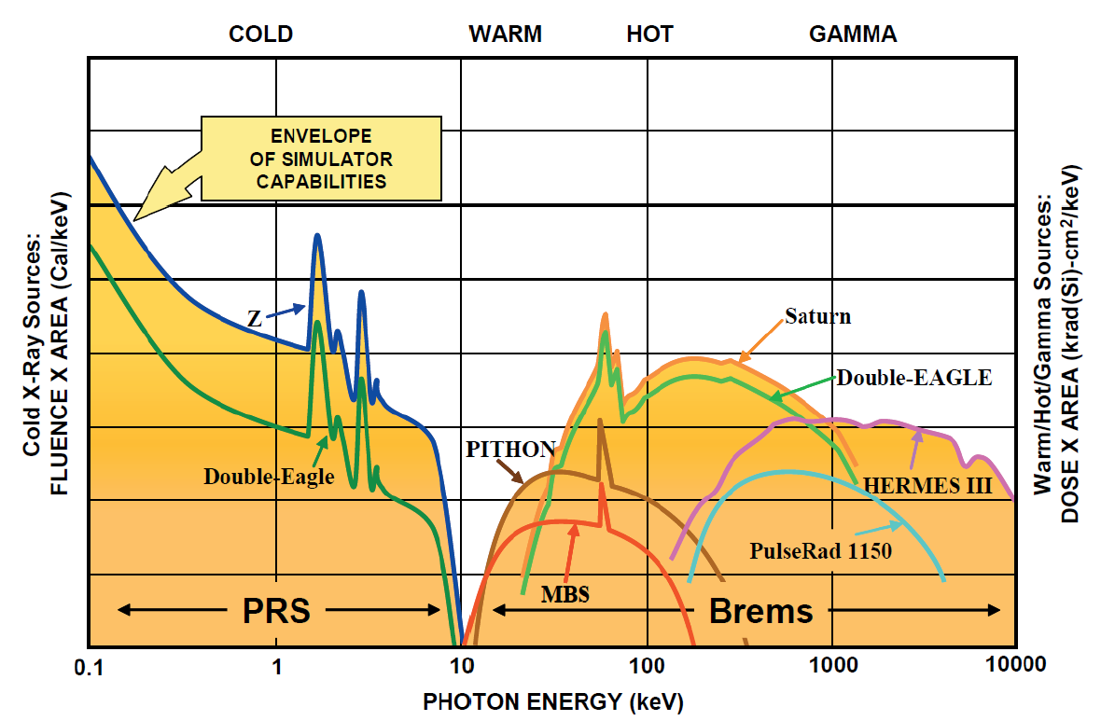
Project Summary: Documented Need
(U//FOUO) DoDI 3150.09 Drove the Formation of the CSOG-N T&E Sub-Group Which Identified Shortfalls in the Cold/Warm X-ray Environments Needed for Nuclear Survivability Certification
National and nuclear policy has changed dramatically and has been reflected in 2018 National Defense Strategy, 2019 Missile Defense Review, 2018 Nuclear Posture Review, and 2017 National Security Strategy
2018 Nuclear Posture review states the US must “Maintain and enhance the computational, experimental, and testing capabilities needed to annually assess nuclear weapons.”
DoD Instruction (DODI) 3150.09 dictates that Mission Critical Systems must be survivable and tested to confirm survivability
UNCLASSIFIED//FOUO
Test Ban Treaty limits NWE testing to above ground simulators
Nuclear Weapons Effects (NWE) certification is accomplished through modeling and simulation (M&S) validated by T&E
M&S must extrapolate simulator output to threat levels
M&S error bars driven by T&E uncertainties as well as modeling errors
(U//FOUO) M&S error bars drive high design margins on Mission Critical Systems
(U//FOUO) After the Cold War, ~75% of DoD’s X-ray Simulator capabilities were shuttered & the remaining facilities have not been modernized since the 1980’s
Notes:
(U//FOUO) The DoD’s Nuclear Weapon Effects (NWE) testing capability was severely curtailed when the United States banned underground nuclear testing (UGT). This loss of capability left DoD with reduced ability to test and certify system performance against NWE, and left limited capability to conduct effects testing at subsystem levels. These effects, essential to testing the survivability of US strategic, satellite, and missile defense systems, include high dose/dose-rate X-ray induced material responses and X-ray induced electronic responses. The shortfalls in our existing NWE test and evaluation (T&E) capabilities have been extensively assessed and documented by Defense Science Boards (DSBs) and the T&E Subgroup of the CBRN Survivability Oversight Group – Nuclear (CSOG-N) in response to DoD Instruction (DODI) 3150.09 [1, 2]. The proposed development of improved X-ray Simulators for Test and Evaluation of Nuclear Survivability (XSTENS) will address two of the seven highest priority shortfalls identified by the T&E Subgroup and will give DoD T&E capabilities with improved fidelity, reproducibility, shot-rate, and reliability, all of which result in reduced testing costs and design margins. The enhanced capabilities will enable testing and certification of subsystems and components in prompt X-ray environments that are the primary nuclear weapon threat to any system that must operate in space. Implementation of this program supports the modernization of the strategic deterrent as called for in the 2018 Nuclear Posture Review [3] and the development of advanced missile defensive and satellite systems
(U//FOUO) DoDI 3150.09 is the instruction that says the mission critical systems (MCS) should be survivable and should be tested to confirm their survivability. The Chemical, Biological, Radiological, and Nuclear (CBRN) Survivability Oversight Group – Nuclear panel was formed in response to assess and monitor the nuclear survivability of all DoD MCS. The T&E subgroup was formed to assess the test capabilities needed to support the instruction, and it identified 7 major capability shortfalls. Cold and warm x-ray test capabilities were 2 of the 7.
(U//FOUO) Improving the capabilities and reliability of NWE T&E supports the objectives of DODI 3150.09 to revitalize DoD system survivability as critical to a credible nuclear deterrent. It also supports: satellite systems [Spaced Based Infrared System (SBIRS), Global Positioning System (GPS) and Advanced Extremely High Frequency (AEHF) block upgrades]; Air Force and Navy strategic system sustainment and life extension programs (LEPs – W78 Replacement, W88-1); strategic system modernization - Long Range Stand-Off (LRSO) cruise missile, Ground Based Strategic Deterrent (GBSD); and multiple Missile Defense Agency (MDA) interceptor programs.

Slide 4
Project Summary: Documented Need
(U//FOUO) Current simulators’ low accuracy and low precision increases errors for M&S extrapolations to threat
Today
Where we can go with CTEIP support
Low accuracy: Simulators output does not represent threat level
Low Fluence: the number of photons
Partial Spectrum: the energies of photons
Low precision: Simulator output has poor reproducibility in terms of fluence, spectrum, and pulse-width
Low reliability: pulsed power failures result in test delays and increased customer test costs
Low accuracy
Low precision
Low accuracy
High precision
M&S
M&S
High accuracy
Low precision
High accuracy
High precision
M&S
Problematic
No M&S
Needed
Not feasible w/o UGTs
All images are UNCLASSIFIED//FOUO
(U//FOUO) Failure to Modernize Aging X-ray Simulator Capabilities will Increase Mission Critical System Design Margins and NWE Test Costs
Notes:
(U//FOUO) The cessation of underground tests (UGT) resulted in a dramatic reduction in our ability to test the performance of many classes of materials, structures, and electronic subsystems in the prompt radiation environments produced by nuclear weapons. The perceived peace dividend and lack of an imminent nuclear threat also led to the closure of most of DoD’s large-scale X-ray above ground test (AGT) capabilities. After many years in which survivability was allowed to be traded away during system development to reduce cost, the issuance of DoD Instruction 3150.09 [2] and USSTRATCOM Instruction 501-02 [4] has emphasized that survivability should be an enforced Key Performance Parameter (KPP) for any new Mission Critical Systems (MCS) and should be evaluated for all existing MCS. These new instructions drove the formation of the Chemical, Biological, Radiological, and Nuclear (CBRN) Survivability Oversight Group (CSOG) – Nuclear panel (CSOG-N) to evaluate compliance. The CSOG-N chartered the Test and Evaluation (T&E) Subgroup to assess the state of the T&E capabilities needed to implement the instructions. The T&E Subgroup Roadmap [1] identified seven critical shortfalls in Nuclear Weapon Effects (NWE) test capabilities with requirements for: 1) an Electromagnetic Pulse (EMP) test capability for ships; 2) a combined blast and thermal test capability for full-scale vehicles and model validation; 3) a pulsed neutron environment for strategic system components; 4) a debris-free cold X-ray (photon energies <15 keV) environment for missile defense and satellite optic components; 5) a subsystem-level dust exposure capability for engine effects, surface erosion, and optical degradation; 6) warm X-ray (15-100 keV) capabilities with improved fidelity for satellite, missile defense, and strategic system certification; 7) and high fluence cold X-ray blow-off impulse simulation capabilities for new reentry system materials and aeroshell testing. The X-ray Simulators for Test and Evaluation of Nuclear Survivability (XSTENS) project will address 2 of the 7 shortfalls (4 and 6) and will support the materials characterization required for blow-off impulse simulations (Shortfall 7).
Achieving an accurate reproduction of the threat x-ray environment cannot be achieved without either underground NWE tests or many billions of dollars for a huge pulsed power facility. The best solution is to achieve higher precision with a range of well characterized, reproducible test environments to measure the responses of system components that can be extrapolated to the threat levels with low uncertainties.

Slide 5
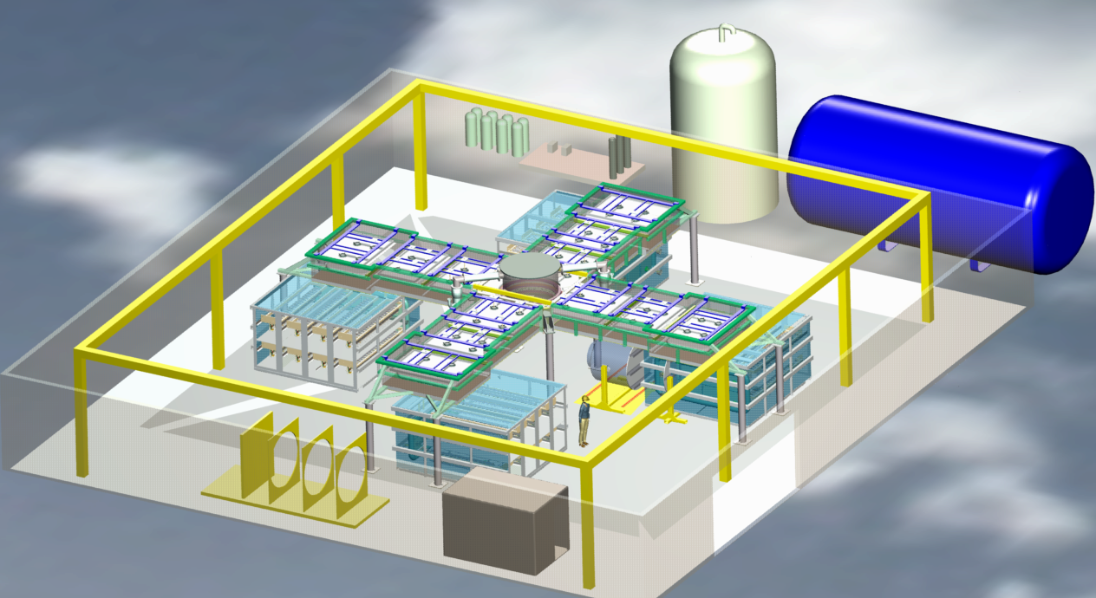
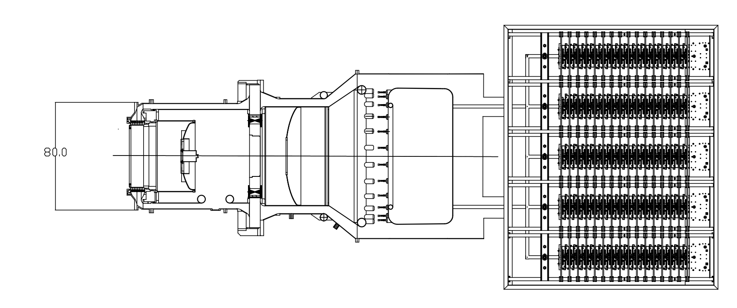
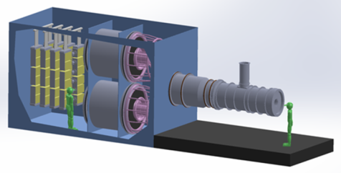
Project Summary: Proposed Capability
Replace existing suite of critical DoD simulators with modern technologies and improved performance
Double-Eagle (DE) will be replaced by Quad-Eagle (QE)
Modern pulsed power components will reduce timing uncertainty that has limited DE performance and reduce maintenance costs
(U//FOUO) Increase cold and warm x-ray output with 2x more electrical output
Reusing/incorporating part of existing DE and its infrastructure enables cost savings and risk reduction
All images are UNCLASSIFIED//FOUO
PITHON simulator will be replaced by PITHON II (PII)
Replace largest pulsed power components with modern systems
Reduced footprint and maintenance costs
Automated control systems improves precision and reduces labor costs
Increase useful shot rate and reduce customer test facility costs
Gamble II (GII) simulator will be replaced by Gamble III (GIII)
Replace antiquated pulsed-power technology with newer, proven technology from Sandia National Labs
Relatively high shot rate maintained and reliability improved
(U//FOUO) Increase current output by 1.5X
Significantly reduce T&E costs, error bars, and extrapolations to threat that drive high design margins. Additionally, capacity will be increased at facilities.
5
Notes:
The XSTENS test capabilities will utilize new pulsed power technologies under development by the Defense Threat Reduction Agency (DTRA) and build upon the existing infrastructure available at the Naval Research Laboratory (NRL) in Washington, DC and the DTRA West Coast Facility (WCF) in San Leandro, CA.
(U//FOUO) Development of well-characterized, high-fidelity cold and warm X-ray sources is required to certify the survivability of mission critical strategic, missile defense, tactical, and satellite systems against nuclear threat environments. The primary challenges for warm X-ray testing are low dose-rates (>100x below threat) and poor spectral fidelity of current AGT simulators. Other limitations include poor fluence uniformity over large test objects, shot-to-shot reproducibility, and diagnostic accuracy.
(U//FOUO) The lack of high fluence X-ray sources drives the need for ion beams to simulate the surface doses for strategic system levels. Existing ion beam sources need to be extended to higher yields to allow testing of 3-dimensional test objects. The main issues with cold X-ray testing for missile defense and satellite systems is poor reproducibility of the test environments, the lack of fluence for large test areas, and the high cost of conducting experiments on the larger DOE machines as well as their lack of availability.

Slide 6
Project Summary: Multi-Service IPT
20 September 2018-Kickoff
Overview of XSTENS Project
ESP Timeline and path forward
TCRD
IPT roles and expectations
30 January 2019-West Coast Facility
Finalization of Use Cases, KPPs, and KSAs
Tour of future simulator locations and Fast Marx demo
Progress on WBS for each project
8-12 April 2019 HEART
Leveraged HEART Conference for individual meetings with Stakeholders
Interactions with stakeholders during final development was one-on-one. As TCRD was finalized with each stakeholder, a final draft was sent to them for review.*
UNCLASSIFIED//FOUO
Name | TCRD Role | Organization
Heather Jiles | Author | DTRA
Paul Adamson | Navy Primary | NRL
Andrew Lerch | Army Primary | USANCA
LTC Greg Van Dyke | AF Primary | AFNWC/NIBF
David Davis | AF Primary | AFSMC
Sarah Armstrong | Support to Navy | NSWC Crane
Mark Ulep | Support to Navy | Navy SSP
Mark Johnson | Support to AF | Aerospace AFNWC
Steve Neville | Support to AF | AFNWC/GBSD
James O’Looney | CTEIP Rep | IDA/CTEIP
Steve Seiler | Support to Author | DTRA
Whit Dailey | Add’l Stakeholder | NNSA
James McComb | Add’l Stakeholder | MDA
Engagement with individual IPT members facilitating the development of the use cases and KPPs/KSAs was ongoing between IPT meetings
*See Backup Slides for quick look of IPT and stakeholder engagements
Notes:
Besides the identified POCs, many other stakeholders provided reviews and inputs into the TCRD.

Slide 7
Approved ESP Budget & Activities
All tables are UNCLASSIFIED//FOUO
ESP Activity | FY19 Funding
TCRD with Use Cases | $20K
WBS with Updated Cost Estimates | $100K
Risk Reduction/Analysis | $150K
Documentation | $30K
Total | $300K
Action Items from Mid-Point | Status
Provide a list of IPT contacts to Services so they can confirm the appropriate representatives are participating. (S: 28 Feb) | COMPLETE- Additionally, each of the services has identified and provided representatives who we are engaging with on the TCRD.
Provide a current draft copy of the TCRD to Service representatives and CTEIP Staff. (S: 28 Feb) | COMPLETE
Prepare a WBS-based cost and schedule for each sub-project for the ESP Close-out Briefing. Please identify the high risk cost items in each budget. Costs for tear down and disposal of existing systems should be identified separately in the WBS. (S: 30 Sep) | COMPLETE
Notes:
Remainder of briefing will touch on each of these topics and their activity during ESP; detailed WBS available for each subproject

Slide 8
Risk Reduction Acquisition Planning
ISS/ASR
Acquisition Planning
RFP
Technical Evaluations
Negotiations
Award
Early FY20
Dec 19
June 19
August 19
November 19
Acquisition Plan formally coordinated within DTRA; contracts will hold RFP until we receive approval from CTEIP/BoD to release
Sole Source CPFF with 14 severable options that separate the three simulator subprojects and reflect relevant stages of development with anticipated award date of early calendar year 2020
Each simulator has the following options: Design to PDR, Final Design to CDR, Development and Installation to IOC, and Demonstration, Optimization, and Documentation to FOC
Phase 0 Finalization
Long-lead Item Purchase Initiation
Structured to allow for staggered starts by subproject (as CTEIP sees fit), incremental funding, and ease of program management
A Memorandum of Agreement (MOA) between DTRA and the Naval Research Laboratory (NRL) was signed by the DTRA Director of Research, Dr. Rhys Williams, and NRL Director of Research, Dr. Bruce Danly, to begin preparations for required facility modifications and ensure sustainment of Gamble III
Acquisition posed a schedule risk to XSTENS due to the complex nature of the program. This risk has been mitigated by engaging early in the acquisition process without actually releasing an RFP. This risk is now low.

Slide 9
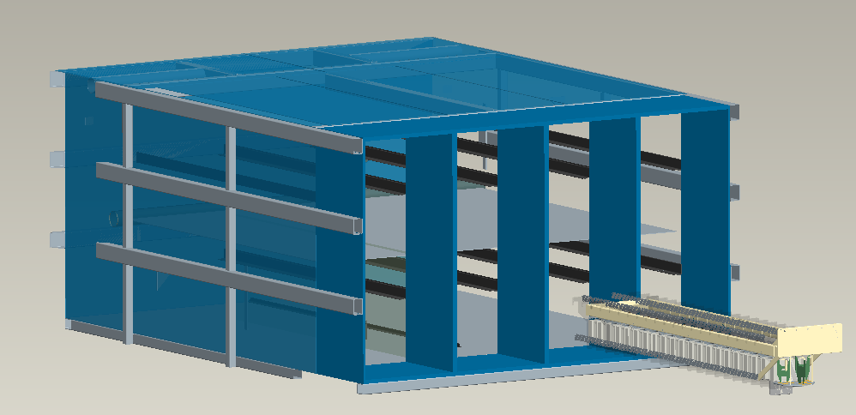
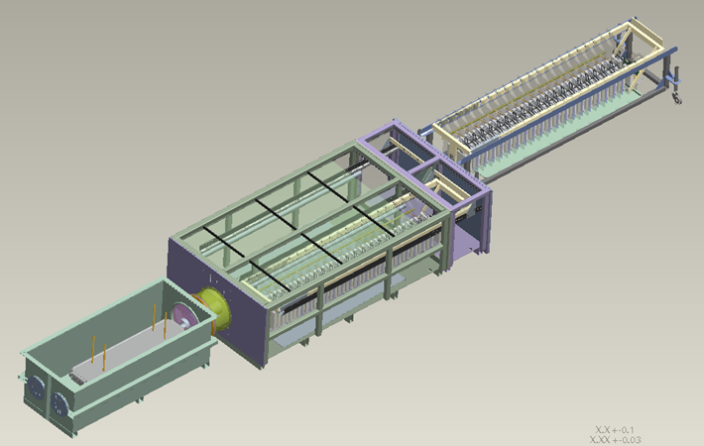
Risk Reduction Technical-Fast Marx Testbed
All images are UNCLASSIFIED//FOUO
(U//FOUO) The Fast Marx poses the biggest technical risk for the XSTENS Program
However, it is based off of the Marx in DTRA’s new SPG machine which is highly successful. Overall risk of the technology is not considered high
To mitigate this risk, DTRA has funded and developed a Fast Marx Testbed (FMT) to use for stressing the technology to the full requirements to achieve TRL 7
(U//FOUO) FMT consists of 2 sub-Marxes, baseline design operating point is ±85 kV but will test at ±100 kV
FMT can be fired into a resistive load about once a minute
(U//FOUO) DTRA has begun the process of developing “Eaglet,” a 20-stage sub-Marx that will be a 1/4 replica of a QE leg
The current FMT design Marx is 5 stages smaller than the current Quad-EAGLE designed Marx
(U//FOUO) We have increased the number of stages from 15 to 20 to increase the energy of the Marx and to allow each Marx to be charged to 85 kV instead of 100 kV. The reduced charge voltage will increase lifetime of the components and decrease fault modes
All testing will be completed well before PDR
(U//FOUO) 1 (of 4) Marx generators for QE Consists 8 sub-Marxes, each 20 stages with ±85 kV charge
(U//FOUO) A 20-stage sub-Marx reflects the planned design for QE and this upgraded test bed, referred to as “Eaglet,” and will be approximately 1/16th of QE

Slide 10
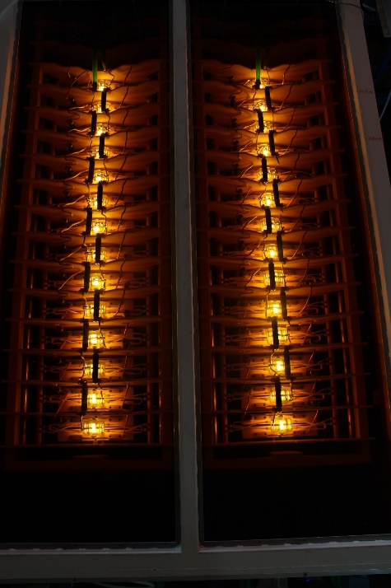
Risk Reduction Technical-Fast Marx Testbed
All images UNCLASSIFIED//FOUO
Notable accomplishments:
Proven that two independent sub-Marxes can be triggered together using a single trigger generator for low jitter (Max Jitter: 15 ns, σ = 5 ns). Current DE Marxes exhibit >65ns Jitter
Resolved arcing to resistors: debubbling by changing the orientation to vertical and changing design to include vent slots in end cap
Our most recent tests have shown no arcing in the FMT at ±85 kV charge which is 1 MV output into ~12 ohm resistive loads
Continued DTRA funded testing before PDR
Tie the outputs of both sub-Marxes together
Removed ground screen between sub-Marxes
Jitter effects on the total output pulse
Positive polarity
Change load resistance
Using capacitors from multiple vendors to begin to address schedule risk of long lead items
±85 kV charge on FMT

Slide 11
Developing Use Cases
UNCLASSIFIED//FOUO
Physics of Burst
Identify the relevant x-ray physics of a nuclear burst, ~75% of a nuclear burst in space is emitted as x-rays with a wide range of energies
Mission Critical Impact
User Feedback
Develop use cases based on the physics of the nuclear weapon and the impact on components, with user feedback, that can be used for nuclear survivability testing
Categorize the applicable physics based on its impact to mission critical systems i.e., warm x-rays and cold x-rays will be applicable to different mission critical components
Use Case
Work with users to determine requirements and applicable testing for mission critical systems i.e., What do they need to test and what do they need to learn from this test?
>35 Years of DTRA Testing Experience, feedback from users, requirement reviews, and IPT input fed into the development of use cases

Slide 12
XSTENS Use Cases
UNCLASSIFIED//FOUO
XSTENS
Quad Eagle
Gamble III
PITHON II
Warm X-ray T&E
Debris Free Cold X-ray
High Fluence Cold X-ray
High Fluence Ion Beams
High Fluence E-Beams
Thermomechanical model validation and component certification for strategic systems such as reentry vehicles
System generated EMP model validation & component certification in strategic systems
T&E for Satellite and MDA electronics
Optical component testing on Interceptors & satellites
Optical subsystem testing for Interceptors & satellites
X-ray response characteristics of surface materials for strategic systems such as reentry vehicles
Structural material T&E and model validation for strategic system aeroshell materials, mounts, moveable structures, etc.
3-D component response and operability to blow-off impulse threats
Impulse response and shock propagation characterization of strategic system surfaces
Use Cases & Test Scenarios designed to address T&E for stakeholder KPPs/KSAs for both current and upcoming systems*
*Simulator Specifications (i.e., machine KPPs) and Use Cases/Test Scenarios specifically developed to avoid classification issues
Notes:
(U//FOUO) Strategic missile and reentry, missile defense, and C4ISR satellite systems must confidently perform not only in the natural space environment, but also under the added stresses induced by the environments produced by the detonation of a nuclear weapon in space. A nuclear detonation in space releases most of its energy (~75%) in the form of X-rays which impact any system within a line-of-sight in a pulse with a width less than 100 nanoseconds (ns). The X-rays from a nuclear detonation in space drive a wide range of potentially damaging phenomena: System Generated Electromagnetic Pulse (SGEMP) from the electrons driven off of surfaces by the cold and warm X-rays; Thermomechanical Effects (TME) such as Thermal Structural Response (TSR) and Thermal Mechanical Shock (TMS) due to high doses of warm X-rays that reach structural components; Transient Radiation Effects in Electronics (TREE) from the X-rays and gamma rays that reach internal components; and surface damage of satellite solar arrays, missile defense optical sensors, warheads, and missiles from cold X-rays absorbed in the outer layers of exposed materials. At the highest fluences required of strategic reentry systems, the main cold X-ray threat is impulse and shock generated by the X-ray induced vaporization and blow-off of surface materials.
(U//FOUO) Five different simulator environments (use/test cases) have been identified to address the needed range of cold/warm X-ray effects T&E: (1) warm X-ray sources with a wide range of spectra to characterize the responses of components, electronics, and cables to different threat spectra at fluences generally less than 1 cal/cm²; (2) debris-free (no gas, plasma, or particulate contamination from the source) cold X-rays at fluences typically less than 1 cal/cm² for testing of coated optics, solar arrays, and surface coatings; (3) high fluence (>10 cal/cm²) cold X-rays to characterize the blow-off impulse response of strategic system materials over small areas; (4) ion beams (typically protons) with >10 cal/cm² fluences to simulate the effects of cold X-ray blow-off over large areas and three-dimensional (3D) test objects; and (5) electron beams with fluences >10 cal/cm² to characterize the TSR/TMS response of structures to warm X-ray fluences not currently achievable with an AGT X-ray simulator.

Slide 13
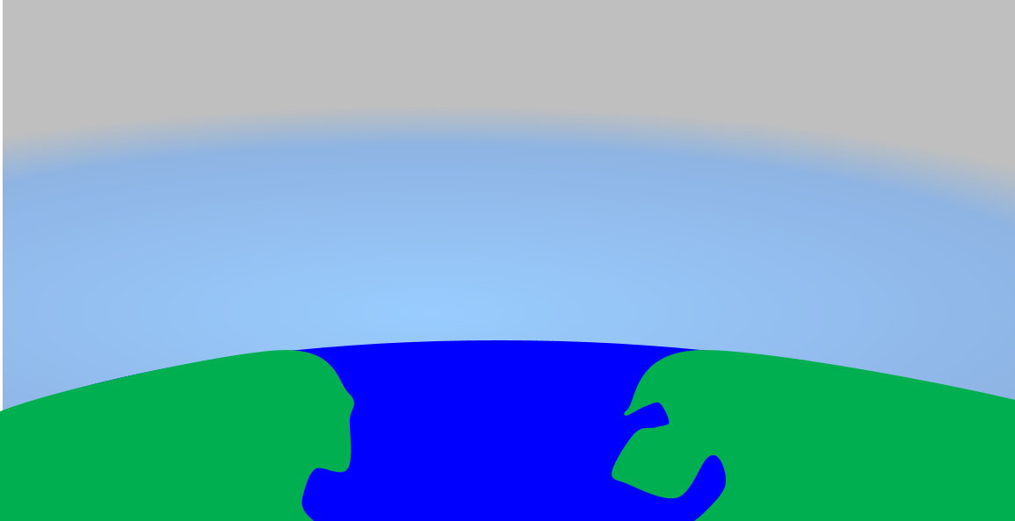
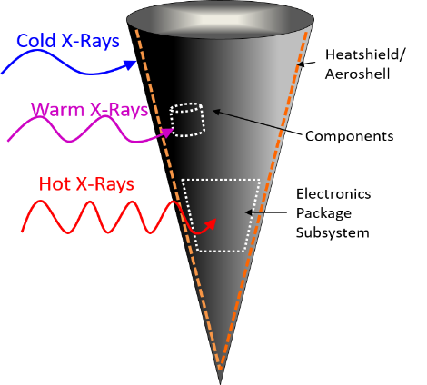
Generic Strategic Reentry System Scenario
This graphic is UNCLASSIFIED//FOUO
Nuclear Engagement exposes reentry systems to damaging X-rays during Mid-Course
Launch and boost phase of an ICBM
X-rays can damage the heat shield and pass through the aeroshell, which can lead to TME and shock. Potentially degrading capabilities
X-Rays on RV
Exoatmospheric vehicles exposed to x-rays will need to evaluate damage/response modes for everything from aeroshells to internal components
Notes:
(U//FOUO) The following examples will focus on Use Cases and Test Scenarios associated with nuclear survivability testing of a re-entry system’s aeroshell. However; other strategic systems and corresponding vehicle components are just as applicable to this program.
(U//FOUO) Cold X-rays from a nuclear weapon detonation in space will be absorbed in a thin (~tens of microns) layer at the surface of the aeroshell. Sudden absorption of energy in such a small volume leads to rapid vaporization/ionization of the front surface, decomposition/melting to a greater depth, and resultant material ablation.
(U//FOUO) High fluence warm X-ray sources are needed to support strategic system thermomechanical effect (TME) component testing and model validation experiments. TME are driven by the differential-ray energy absorption of front surfaces versus back surfaces or of high atomic number (high-Z) versus low atomic number (low-Z) materials that are bonded together. The difference in X-ray absorption causes one side to rapidly heat and expand more than the other side. This drives three-dimensional stresses and shock waves in the cases of thermostructual response and thermomechanical shock. At boundary surfaces between high- and low-Z materials, this can produce extreme stresses that can fracture components. Since the stress required to damage a boundary layer is very difficult to model, testing is needed to determine shear strengths at high strain rates.
(U//FOUO) Hotter X-rays are not being considered under XSTENS as our simulator capabilities adequately cover this range of photons.

Slide 14
Generic Strategic Reentry System Certification Efforts
M&S of dose & depth of penetration that drive blowoff and impulse
This graphic is UNCLASSIFIED//FOUO
COLD
Basic response of heatshield material to determine impulse
validate material response model & extrapolate to threat
Coupon testing of aeroshell layups at simulated threat level
Validate shock and impulse response models
Testing of 3D Components & subsystems
Validate 3D structural response models
QE Cold X-ray T&E
GIII Ion Beam T&E
Certification
M&S of response to combined cold/warm effects
M&S of dose & depth of penetration that drive Thermostructural Response (TSR)
Basic response of structural materials to determine heating effects
validate material response model & extrapolate to threat
Coupon testing of materials at simulated threat level
Validate TSR response models
Testing of 3D Components & subsystems
Validate 3D structural response models
WARM
QE Warm X-ray T&E
PII Electron Beam T&E
Test data drives the certification process for both T&E and M&S, when high error bars are present they propagate through the certification process resulting in high design margins and uncertainty for the warfighter; XSTENS will reduce these uncertainties for the warfighter
Notes:
(U//FOUO) No existing or realistic future AGT radiation source can simultaneously stimulate the full range of system responses to a threat-level X-ray exposure. This requires that testing be done at lower fluence levels and levels of integration, and that the full range of responses be assessed separately. The results of the T&E experiments must be extrapolated to threat levels using modeling and simulation (M&S). The uncertainty in the results of the extrapolations scale with the uncertainties in the subscale test results combined with the uncertainties in the model’s validity, the test spectral and temporal fidelity to the required threat, and characterization uncertainty of the test environment. The validation of the models is conducted using the same test environments as the component certification T&E. The design margins built into a survivable system’s certification requirements are proportional to the final uncertainty of the response assessment, there is a high degree of leverage placed on the fidelity and reproducibility of the test capabilities. High design margins in general increase system costs; sometimes dramatically if the uncertainties drive the requirements for more expensive hardened technologies.

Slide 15
Translating User Requirements to Use Cases and Test Scenarios
UNCLASSIFIED//FOUO
XSTENS
Quad Eagle
Gamble III
PITHON II
Warm X-ray T&E
Debris Free Cold X-ray
High Fluence Cold X-ray
High Fluence Ion Beams
High Fluence E-Beams
Thermomechanical model validation and component certification for strategic systems such as reentry vehicles
System generated EMP model validation & component certification in strategic systems
T&E for Satellite and MDA electronics
Optical component testing on Interceptors & satellites
Optical subsystem testing for Interceptors & satellites
X-ray response characteristics of surface materials for strategic systems such as reentry vehicles
Structural material T&E and model validation for strategic system aeroshell materials, mounts, moveable structures, etc.
3-D component response and operability to blow-off impulse threats
Impulse response and shock propagation characterization of strategic system surfaces
For specific system scenario, highlighted Use Cases/Test Scenarios address reentry system T&E necessary to meet survivability KPP(s)

Slide 16
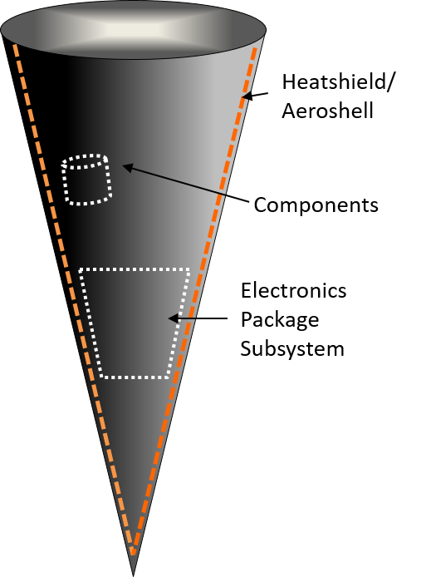
Generic Reentry Vehicle Aeroshell Test Scenario (Cold) Quad Eagle (QE) Cold X-rays*
UNCLASSIFIED//FOUO
Test Scenario
User Objective: Enable the certification of new strategic reentry system aeroshells for nuclear survivability by determining the basic response properties of surface materials and to validate a model of the responses to threat-level fluences
Key Functions of Test: Expose simple test objects, such as a flat disc-shaped coupon, to a well-characterized and reproducible X-ray spectrum that can provide doses and depth of penetration that are representative of the desired threat spectrum
User Tests:
Dose depth profiles for strategic materials
Variations in the impulse response of surface materials due to aging effects
Different formulations of composite materials
Test Parameters: Multiple reproducible cold x-ray shots needed to characterize material and model validation. Data to be collected includes the effective sublimation energy (minimum energy needed to begin the vaporization) and the variation in the impulse versus deposited energy
QE Cold X-rays characterize the basic response of heatshield material to determine impulse
Heatshield/surface material coupon; often complex composite materials: typically graphite fiber embedded in a resin matrix
Target material is destroyed during test but diagnostics are able to measure the sublimation energy of a sample which is used in M&S to validate code and gives the necessary dose-depth energy deposition profile which can be used by GIII to reach threat levels
All images are UNCLASSIFIED//FOUO
*Warm X-ray Test Scenario is similar but with substructure materials
(U//FOUO) NIF is currently the only other test facility available to DOD for high-fluence, low-debris cold x-ray environments with only 14 shot days a year available for the entire National Security Applications community
Notes:
(U//FOUO) The goal of the High Fluence X-ray Use Case is to enable the certification of new strategic reentry system aeroshells for nuclear survivability. Cold X-rays from a nuclear weapon detonation in space will be absorbed in at the surface of the aeroshell leading to rapid vaporization/ionization of the front surface, decomposition/melting to a greater depth, and resultant material ablation. Momentum conservation causes this rapid material blow-off to generate a high-pressure shock wave that propagates into the reentry vehicle. This wave in turn can damage not only the aeroshell, but also internal components. Additional damage can result from spalling of the aeroshell’s inner surface. Ablation and blow-off will also alter the surface shape and texture, which may compromise further the aerodynamics of the reentry vehicle.
(U//FOUO) Modeling of the surface response to high fluence X-rays is complicated by several factors. Reentry vehicle surface materials are often complex composite materials: typically graphite fiber embedded in a resin matrix. Such materials can exhibit a range of properties depending on their conditions of manufacture, water content, and micro-voids.
(U//FOUO) The threshold objective for this Use Case is to increase the cold X-ray yield available on a DoD simulator by at least a factor of two to over 40 kJ of photon energies greater than 3 keV (threshold KPP) to exceed the threshold fluences at the test coupons needed to drive the blow-off phenomena and support strategic materials blow-off response characterization.

Slide 17
Generic Reentry Vehicle Aeroshell Test Scenario (Cold) Determining KPPs and KSAs for QE
Allows material studies from just below threshold of blow-off to at least twice threshold fluence. This is a critical regime for determining the sublimation energy of surface materials.
UNCLASSIFIED//FOUO
Attribute | Threshold | Objective | Current
KPP: PRS Yield of X-rays >3 keV | 40 kJ | 80 kJ | 20 kJ
KPP: PRS Line-of-Sight Access for Diagnostics and Test Articles | PRS viewable within 10° of normal to the Z axis at the center of the x-ray source at up to 3 meters in at least 4 azimuthal directions | PRS viewable within 10° of normal to the Z axis at the center of the x-ray source at up to 3 meters in 8 azimuthal directions | PRS viewable within 10° of normal to the Z axis at the center of the x-ray source at up to 3 meters in 3 azimuthal directions
KPP: Cold X-ray Quality Metric | 80% of shots within ±15% of intended output level | 90% of shots within ±15% of intended output level | 60% of shots are within ±15% of intended output level
KSA: Cold X-ray Pulse Width | >7 ns FWHM | >20 ns FWHM | 7-10 ns FWHM
KSA: Cold X-ray Shot Rate | 8 good shots/week | 10 good shots/week | 5 good shots/week
KSA: Cold X-ray Cost per Good Shot | $13K | $10K | $22K
User’s require multiple, reproducible shots at a reasonable cost to collect enough data for model validation to reduce error bars and design uncertainty. Limited by physics of simulator
Driven by physics of environment
(U//FOUO) Driving Assumptions for Test Scenario: Air Force and Navy strategic weapon reentry system sustainment and development programs and associated warhead LEPs will require the characterization of heat shield and surface protection materials.
An aeroshell from a reentry vehicle was used as an example; similarly, this test scenario would support other strategic systems and corresponding vehicle components

Slide 18
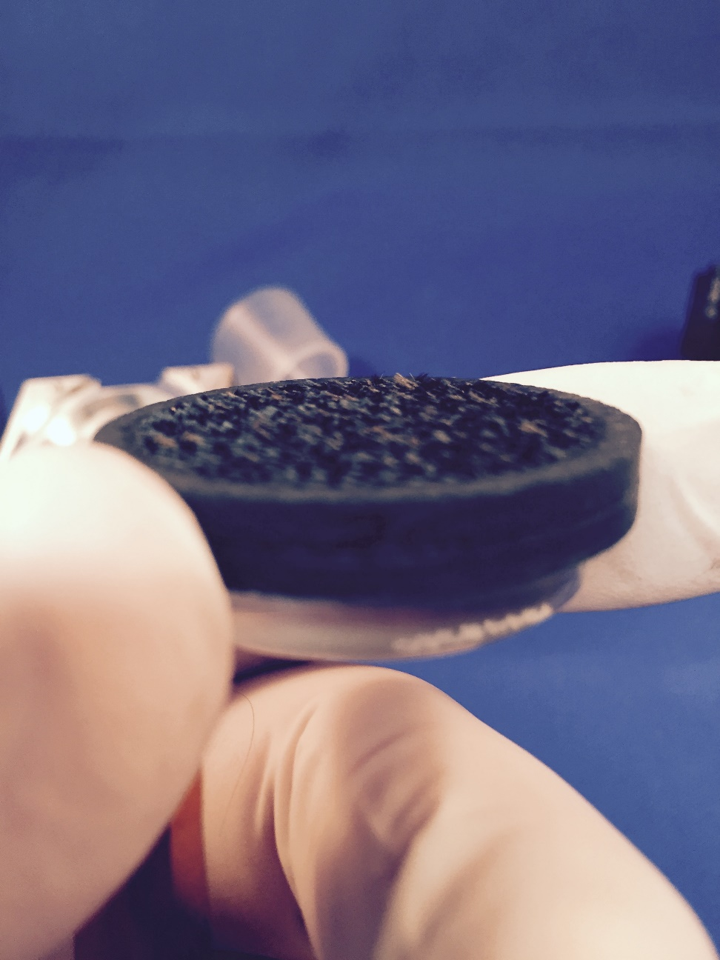
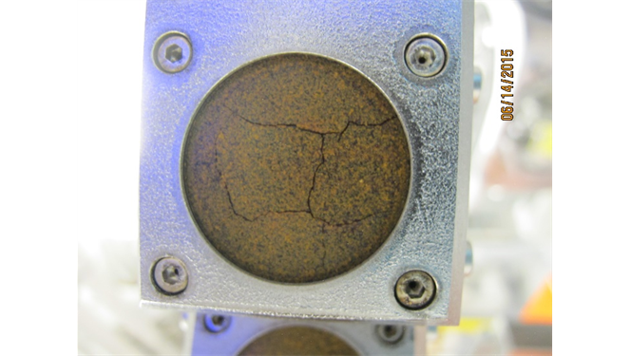
Generic Reentry Vehicle Aeroshell Test Scenario (Ions) Gamble III (GIII) Ion Beams
UNCLASSIFIED//FOUO
GIII Ion Beams, a surrogate for cold x-rays, can reach threat level fluences
Test Scenario
User Objective: Understand the response properties of a reentry system’s aeroshell layup and to validate a model of the responses to threat-level fluences for certification of survivability
Key Functions of Test: Utilizing dose depth information from cold x-ray testing, provide relevant and reproducible surrogate environment at threat level with ion beams to assess blowoff, spalling, and damage
User Test:
Materials analysis: new and/or aging materials
Certification of aeroshell materials/structures at threat level
3-D Component Response and Operability to Blow-off Impulse Threats
Model Validation
Test Parameters: Multiple reproducible ion beam shots at threat level environment needed to characterize aeroshell layup and model validation. Data to be collected includes response to impulse, blow off, and shock propagation
Possible Aeroshell layup for T&E including heatshield, substructure, & adhesive. Can include complex 3-D shapes
Blow-off of heatshield material and impulse to body
Besides limited access at NIF, surrogate Ion beams are the DOD’s only blowoff capability. For future maneuverable systems, understanding the impact of blowoff on maneuverability and re-entry is critical for ensuring survivability and effectiveness of systems
Aeroshell material exposed to cold x-rays can experience spalling and damage; potentially impacting mission performance
All images are UNCLASSIFIED//FOUO
Notes:
(U//FOUO) The blow-off impulse phenomenology discussed in the previous two slides can be simulated using ion beams after the dose depth profiles are well understood with actual x-rays. Ion beams can be generated on a pulsed power machine with greater energy efficiency than X-rays. An ion beam diode can convert >30% of the electrical energy to a beam that can be directed towards a test object. A PRS typically converts less than 20% of the electrical energy into useful X-ray energies. The X-rays are also emitted into 4π steradians such that the fluence falls off as the square of the distance from the source. The excess energy in an X-ray source generates large amounts of plasma and particulate debris that hits the test objects within a few microseconds after the X-rays. The debris impulse and surface damage from an X-ray source is usually greater than is caused by the X-rays themselves. Ion beams generate less debris, can have much larger stand-off distances to the test object and can also be used with debris shields that greatly reduce debris effects. Ion beams are thus an attractive surrogate for cold X-rays because: they can supply higher fluences and larger test areas using DoD machines; their deposition profile can be designed to be similar to that of cold X-rays for relevant materials; they have better temporal fidelity; allow for post-test surface characterization; and allow blow-off material composition to be diagnosed in real time.
(U//FOUO) The depth-dose profile of the ion beam should match that of the portion of the threat X-ray spectrum that is responsible for driving the blow-off impulse i.e., what we determined 2 slides ago on QE

Slide 19
Reentry Vehicle Test Scenario (Ions) Determining KPPs and KSAs for GIII
Area and fluence allows for analysis of non-linear responses & determination of failure levels of complex structures
UNCLASSIFIED//FOUO
Attribute | Threshold | Objective | Current
KPP 2.1.1.1 Ion Beam Fluence-area Product at 1.2 MeV Endpoint Energy | 1,500 cal | 4,000 cal | 1,000 cal
KPP 2.1.1.2 Pulse Polarity | Negative or 80% Positive | Negative or 100% Positive | Negative or 80% Positive
KPP 2.1.1.3 Ion Beam Fluence Uniformity | ±25% over 100 cm2 | ±10% over 200 cm2 | ±50% over 50 cm2
KSA 2.1.1.4 Ion Beam Pulse Width | >50 ns FWHM | Variable up to 100 ns FWHM | 58 ns FWHM
KSA 2.1.1.5 Ion Beam Shot Rate | 15 good shots/week | 20 good shots/week | 10 good shots/week
KSA 2.1.1.6 Ion Beam Cost per Good Shot | $4.3K | $3.3K | $6.5K
Driven by user test requirements/needs for material characterization and certification but bounded by technology
Driven by physics of the environment
(U//FOUO) Driving Assumptions for Test Scenarios: On-going and future reentry system LEPs will need to test/model both new and legacy heat shield and aeroshell components and materials for model validation and stockpile stewardship. Additionally, advanced reentry systems will be needed to maintain a credible nuclear deterrent and will require significant model validation experiments for materials, structural elements, and component testing.
An aeroshell from a reentry vehicle was used as an example; similarly, this test scenario would support other strategic systems and corresponding vehicle components
Notes:
(U//FOUO) The rationale for Ion Beam Subproject KPP 2.1.(1,2).1 is the need to increase the fluence-area product of the ion beam environment to enable the testing of 3-dimensional test objects for model validation experiments. A threshold fluence-area product of 1,500 cal is enough to produce an average fluence of 10 cal/cm2 over a test object is ~12 cm in diameter. This size and fluence will support analysis of non-linear responses and determination of failure levels of complex, multi-material structures that will be needed for future strategic system certification.
(U//FOUO) The rationale for Ion Beam Subproject KPP 2.1.(1,2).2 is the need for GIII to support a wide range of capabilities as has been done in the past to continue to support other customers. Most of the other T&E capabilities such as gamma ray simulation experiments will require the negative polarity operation that is the standard operating mode of most pulsed power systems. Ion beams require positive polarity operation if the test object is to be fielded at ground potential. Reversing the machine polarity can be done with a small penalty in peak operating voltage if the switching, insulator, and power flow components are designed for it.
(U//FOUO) The rationale for Ion Beam Subproject KPP 2.1.(1,2).3 is the need to reduce T&E uncertainties to reduce design margins. Non-uniformities of the fluence across a test object directly contribute to increased error bars in the test results. The threshold requirement of ±25% over 100 cm2 is a factor of two improvement over the current capability and represents the peak and minimum fluences at any point within the test area normalized to the average fluence. Diagnostics that can characterize the actual fluence distributions during a test can help to reduce the impact of the non-uniformity.

Slide 20
Generic Reentry Vehicle Aeroshell Test Scenario (E-beam) PITHON II Electron Beam
UNCLASSIFIED//FOUO
Test Scenario
User Objective: Enable the certification of new strategic reentry system aeroshells for nuclear survivability by determining the Thermostructural Response at threat levels and to validate complex 3D models
Key Functions of Test: Expose simplified test articles for model validation and structural system components to a well-characterized and reproducible electron beam that can provide doses and depth of penetration that are representative of the desired threat spectrum
User Tests:
Non-linear responses of strategic materials
Variations in the impulse response of surface materials due to aging effects
Different formulations of composite materials
Test Parameters: Multiple, reproducible electron beam shots needed to characterize materials and validate TSR models. Data to be collected includes the time history of the material/structural deformation (ringing and warping), joint/interface damage, and permanent deformations that can cause targeting errors.
PITHON II electron beams used to simulate X-ray energy deposition to characterize the responses of aeroshell layups
Aeroshell layups may include heat shield, bonding, substructure, windows, and movable vanes
Heat shield
Bond layer
Aluminum Substructure
Electron beam energy is chosen to provide a dose-depth profile that is close to that of the threat X-ray spectrum. This provides the same heating and rapid thermal expansion that drives the TSR phenomena.
All images are UNCLASSIFIED//FOUO
(U//FOUO) There is no current of realistically achievable warm X-ray source that can achieve threat fluences over sufficient areas to validate TSR models or certify components; electron beams are the best alternative
Notes:
(U//FOUO) The Electron Beam Use Case goal is to enable the certification of new strategic reentry system aeroshells for nuclear survivability. Warm X-rays from a nuclear weapon detonation in space can penetrate a system’s heat shield and be absorbed in the aeroshell, interior components, and mounting structures. The absorbed energy leads to rapid and differential heating of the materials which drives TME such as Thermomechanical Shock (TMS) and Thermostructural Response (TSR). TMS is caused by the rapid outward expansion of a heated surface layer that drives a high pressure shock wave into the material. This can lead to spalling of the inner surface and damage to interior components or mounts. TSR is caused by the differential heating of inner and outer surfaces or near and far sides of the system. This differential heating causes the aeroshell structures to warp and vibrate, and may lead to debonding of the heat shield, permanent deformation, and/or damage to internal components.
(U//FOUO) The rationale for Electron Beam Subproject is the need for higher, more uniform fluences over large areas to enable Thermostructural Response model validation and component certification of strategic system materials and structures. The existing electron beam capability does not provide a sufficiently uniform or shot-to-shot reproducible fluence at the actual fluence at the surface of a test object to be characterized without large error bars. The threshold total fluence-area product for the beam energy delivered to a test object is to provide no less than the current capability while also delivering the improved fluence uniformity.

Slide 21
Reentry Vehicle Test Scenario (E-beam) Determining KPPs and KSAs for PITHON II
Fluence-area product allows for characterization of TSR of materials and structures at sufficient size to validate models; uniformity is a critical element of the T&E error that drives design margin
UNCLASSIFIED//FOUO
Attribute | Threshold | Objective | Current
KPP 3.1.1.1 Electron Beam Fluence-area Product at 1.5 MeV Endpoint Energy | 18,000 cal | 36,000 cal | 18,000 cal
KPP 3.1.1.2 Electron Beam Fluence Uniformity | ±15% over 1,000 cm² | ±5% over 1,600 cm² | ±29% over 800 cm²
KSA 3.1.1.3 Electron Beam Pulse Width | <100 ns FWHM | <25 ns FWHM | 100-120 ns FWHM
KSA 3.1.1.4 Electron Beam Shot Rate | 15 good shots/week | 20 good shots/week | 10 good shots/week
KSA 3.1.1.5 Electron Beam Cost per Good Shot | $7.5K | $5.5K | $11K
Driven by physics of the environment and technology limitations
Driven by user test requirements/needs for response characterization and design certification but bounded by technology
(U//FOUO) Driving Assumptions for Test Scenarios: On-going and future reentry system LEPs will need to test/model both new and legacy aeroshell components and structure for model validation and stockpile stewardship. Additionally, advanced reentry systems will be needed to maintain a credible nuclear deterrent and will require significant model validation experiments for materials, structural elements, and component testing.
An aeroshell from a reentry vehicle was used as an example; similarly, this test scenario would support other strategic systems and corresponding vehicle components
Notes:
(U//FOUO) The rationale for Electron Beam Subproject KPP 3.1.1.1 is the need for higher, more uniform fluences over large areas to enable Thermostructural Response model validation and component certification of strategic system materials and structures. The existing electron beam capability does not provide a sufficiently uniform or shot-to-shot reproducible fluence at the actual fluence at the surface of a test object to be characterized without large error bars. The threshold total fluence-area product for the beam energy delivered to a test object is to provide no less than the current capability while also delivering the improved fluence uniformity of KPP 3.1.1.2.
(U//FOUO) The rationale for Electron Beam Subproject KPP 3.1.1.2 is the need to reduce T&E uncertainties to reduce design margins. Non-uniformities of the fluence across a test object directly contribute increased error bars in the test results. The threshold requirement of ±15% over 1000 cm2 is a factor of two improvement over the current capability and represents the peak and minimum fluences at any point within the test area normalized to the average fluence. Diagnostics that can characterize the actual fluence distributions during a test can help to reduce the impact of the non-uniformity.

Slide 22
TCRD Status
TCRD is complete and ready for immediate staffing/signatures
Final draft was sent to IPT, CTEIP representative, and OTICC prior to ESP out brief
Comments have been incorporated
TCRD clearly splits out each of the subprojects (QE, GIII, and PII) , their respective Use Case/Test Scenarios, and their KPPs/KSAs
KPPs/KSAs provided in backup slides for each simulator
Rationale, individually detailed in the TCRD, is driven by the need to reach non-linear effects, create highly reproducible shots, increased area to reach subsystem levels or larger test objects, and better representation of the physics environment
Threshold numbers are generally the minimum required values to demonstrate a particular effect (i.e., minimum value needed for sublimation); however, most objective values are considered very achievable with available technology
Trade space generally exists between fluence and area.
Higher fluence can more easily be achieved with smaller area and larger area is more easily achieved by trading fluence
Additionally, trade space exists in the initial number of spare and duplicate parts needed to increase the shot rate and to reduce maintenance time
Trade space exists for which subproject should be funded
TCRD requirements developed to best meet the needs of customers with available technology

Slide 23
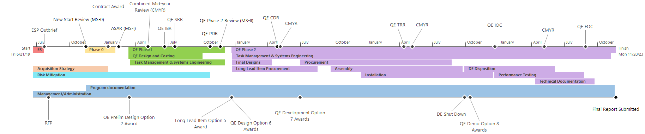
QE WBS-Based Budget and Schedule
All graphs are UNCLASSIFIED//FOUO
FY20 - $3.1M
FY21 - $26.8M
FY22 - $12.6M
FY23 - $1.5M
FY24 - $1M
Cost by Major Element
Phase 0/Risk Reduction | $0.8M
Phase 1-Design Activities | $2.3M
Phase 2- Final Design, Prep, Testing and Quality Control | $7.8M
Phase 2- Long Lead Item Procurement (Capacitors) | $8.2M
Phase 2- Procurement | $21.3M
Phase 2- Final Installation and DE disposition | $3.6M
Phase 2- Demonstration | $1M
Total | $45M
The resolution of this ROM is ± 15% for all elements
Detailed design activities, including procurement quotes from vendors, in Phase I should eliminate significant amount of remaining uncertainty
The costs have increased from the original proposal due to the inclusion of a significant check-out/optimization phase after IOC, the disposition of remaining Double-EAGLE components, and the addition of required customer support data acquisition and screen room capabilities
Notes:
Note: Risk mitigation in the timeline reflects both the DTRA funded activities as well as the proposed CTEIP funded activities, see the slide on the detailed Phase 0 WBS for a breakdown. The “Cost by Major Element” only reflects the proposed CTEIP

Slide 24
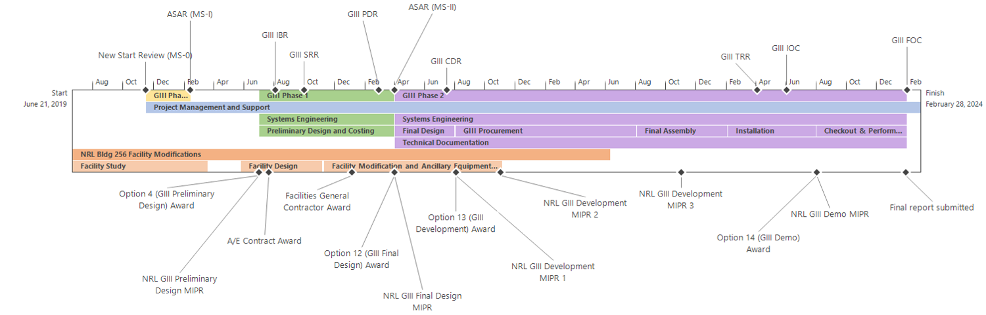
Gamble III WBS-Based Budget and Schedule
All graphs are UNCLASSIFIED//FOUO
FY20 - $1.6M
FY21 - $5.9M
FY22 - $4.6M
FY23 - $2M
FY24 - $0.9M
Cost by Major Element
Facility modifications unique to Gamble III included; NRL contributing $800k
Cost uncertainty <20% for all items in WBS with the exception of facility modifications and L-3 Machine Tank/Control System
Current NAVFAC preliminary estimate for total facility modification is $2.8M (including $800k funded by NRL)
Based on experience, NRL estimates ~50% cost uncertainty at this time
NAVFAC to complete in house Facility Study to reduce uncertainty prior to Gamble III Phase 1 and NAVFAC A/E Contract Award
The NRL facility modifications are greater than the original estimate and the post IOC demonstration/optimization has been added
Phase 0/Risk Reduction | $0.2M
Facility Modifications | $2M
Phase 1-Design Activities | $1.8M
Phase 2- Final Design, Assembly, & Installation | $3M
Phase 2- Procurement | $7M
Phase 2- Demonstration | $1M
Total | $15M

Slide 25
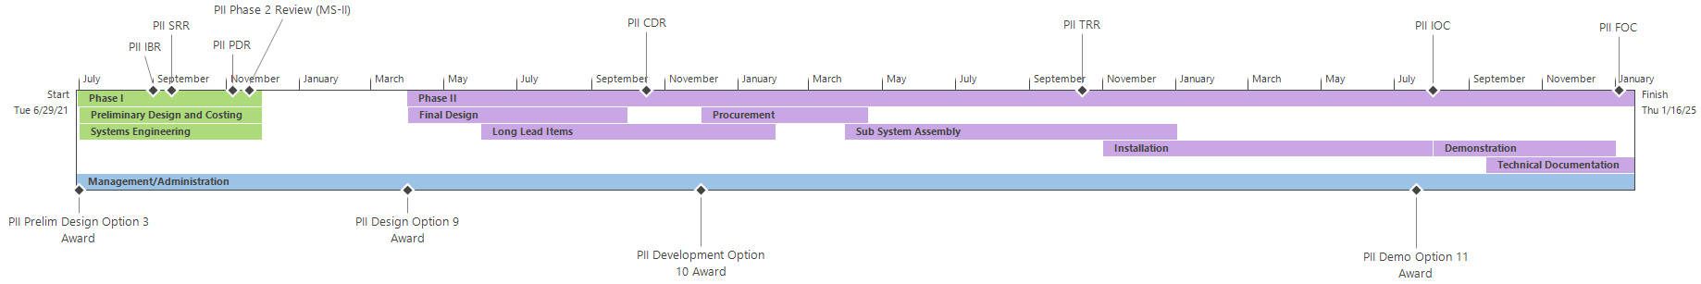
PITHON II WBS-Based Budget and Schedule
All graphs are UNCLASSIFIED//FOUO
FY21 - $1.5M
FY22 - $3.5
FY23 - $8
FY24 - $2M
Cost by Major Element
Phase 0/Risk Reduction | N/A
Phase 1-Design Activities | $1.5M
Phase 2-Long Lead Procurement (Capacitors) | $3M
Phase 2- Final Design, Assembly, & Installation | $4.5M
Phase 2- Procurement | $5M
Phase 2- Demonstration | $1M
Total | $15M
The resolution of this ROM is ± 15% for all elements
Phase 0 activities and risk reduction from Quad Eagle can be leveraged here
Detailed design activities, including quotes from vendors, in Phase I should eliminate significant amount of remaining uncertainty
Increased cost estimate includes upgrades of the output lines to improve performance and post IOC checkout/optimization

Slide 26
Summary of Identified Risks
UNCLASSIFIED//FOUO
Risk |  |  | Mitigation Approach
Technical
 | Fast Marx Technology | Medium | DTRA funded test bed; Technology will be demonstrated to TRL 7 at the ”System prototype in an operational Environment” at quarter scale on the Eaglet Test Bed before PDR.
Schedule
 | Capacitors | Medium | Vendor capacitor testing starting early
 | Long Lead Materials-Significant material costs early in the 36 month Phase 2 start to IOC for QE | Medium-high | Carefully plan a staged procure-assemble-test program
Cost
 | Remaining cost uncertainties | Low-medium | Obtain hardware quotes as soon as possible and adjust the design to cost if necessary. Phase I should eliminate remaining cost uncertainties

Slide 27
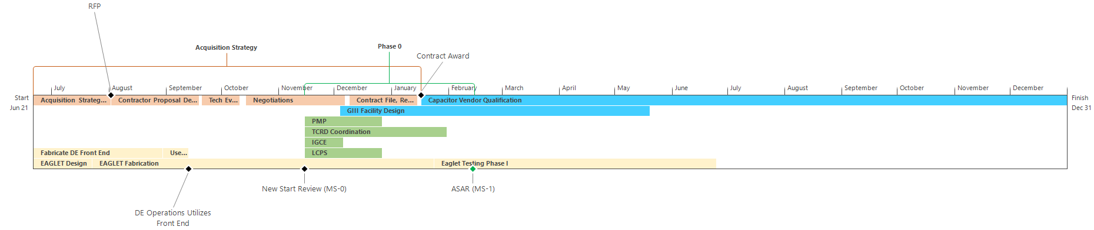
Phase 0 Planning
FY20 - $1M
UNCLASSIFIED//FOUO
DTRA Funded Risk Reduction
Phase 0 Deliverables ($145k in manpower)
Acquisition
CTEIP Funded Risk Reduction ($800k Capacitor Qualification, $55K for Facility Design)
The extensive DTRA acquisition planning that has been completed to date makes us confident in our acquisition strategy
Government Cost Estimate completed, Acquisition Strategy and Plan completed, drafts of LCSP and PMP developed
(U//FOUO) Saturn (DOE x-ray capability) refurbishment is tentatively planned for FY22/FY23 and will require schedule coordination, because DE at the WCF is the primary alternative, to minimize any hiatus in the availability of test capabilities needed to support strategic deterrent modernization
(U//FOUO) Saturn will be completely down for a minimum of 18 months
DTRA is coordinating with program offices and labs to make sure there is complete transparency in timeline and availability
QE will be developed in a separate high bay to minimize downtime of DE
Recommend a 3 month Phase 0 to finalize documentation; simultaneously executing several risk reduction activities. Totaling $1M

Slide 28
Summary and Recommendation
TCRD is complete and ready for immediate staffing/signatures; recommend formal coordination
Technical risk reduction being funded by DTRA and will be completed before any PDRs
Additionally, NRL is contributing ~$800k for site modifications
DTRA and NRL have the current responsibility to assure the availability of their own simulators and to oversee the business models that provide the operation and maintenance of the machines
This approach has sustained the simulators for over 40 years at both facilities
This responsibility will continue for the new XSTENS capabilities
Sole Source CPFF contract vehicle, with severable options, ready for RFP release to contractor
Contract structured to completely separate the subprojects allowing for staggered or delayed starts, incremental funding, and ensuring ease of program management
DTRA Acquisition Strategy Review and Acquisition Plan completed, coordinated, and fully signed
Recommend release of RFP upon CTEIP/BoD program decision
Recommend all three subprojects move in to Phase 0 (~3 months) concurrently followed by respective Phase I’s to truly understand the design costs and reduce risk
Most risks can be significantly reduced with detailed design work for simulator
Actual execution of each subproject’s Phase II can be staggered as CTEIP sees fit
XSTENS is ready to move in to Phase 0

Slide 29
Back Ups

Slide 30
Wrap Up Cost for XSTENS
UNCLASSIFIED//FOUO
 | FY21 | FY22 | FY23 | FY24 | FY25 | Total
QE | 3.1 | 26.8 | 12.6 | 1.5 | 1 | $45
GIII | 1.6 | 5.9 | 4.6 | 2 | .9 | $15
PII |  | 1.5 | 3.5 | 8 | 2 | $15
Total | $4.7 | $34.2 | $20.7 | $11.5 | $3.9 | $75M

Slide 31
Budget Status
All graphs are UNCLASSIFIED//FOUO
Data as of 6/12/2019

Slide 32
QE KPPs/KSAs
UNCLASSIFIED//FOUO
Attribute | Threshold | Objective | Current
KPP 1.1.1.1 High Fluence Warm Dose-Area | 6 cal/g(Au) Over 100 cm² With ±15% uniformity <1,200 keV endpoint Debris-free | 10 cal/g(Au) Over 200 cm² With ±10% uniformity <750 keV endpoint Debris-free | 4.5 cal/g(Au) Over 25 cm² With ±20% uniformity 1,200 keV endpoint Debris-free
KPP 1.1.(2,3).1 Low Endpoint Energy Warm Fluence-Area | 100 mcal/cm² over 600 cm² with ±10% uniformity 250 keV endpoint debris-free | 400 mcal/cm² over 1000 cm² with ±5% uniformity 180 keV endpoint debris-free | 65 mcal/cm² over 300 cm² with ±10% uniformity 250 keV endpoint debris-free
KPP 1.1.(1,2,3).2 Warm X-ray Pulse Width | < 50 ns Full Width Half Maximum (FWHM) | <25 ns FWHM | <50 ns FWHM
KPP 1.2.(1,2,3).1 Plasma Radiation Source (PRS) Yield of X-rays >3 keV | 40 kJ | 80 kJ | 20 kJ
KPP 1.2.(1,2).2 PRS Line-of-Sight Access for Diagnostics and Test Articles | PRS viewable within 10° of normal to the Z axis at the center of the X-ray source at up to 3 meters in at least 4 azimuthal directions | PRS viewable within 10° of normal to the Z axis at the center of the X-ray source at up to 3 meters in 8 azimuthal directions | PRS viewable within 10° of normal to the Z axis at the center of the X-ray source at up to 3 meters in 3 azimuthal directions
KSA 1.1.(1,2,3).3 Pulse Polarity | Negative Polarity or 80% Positive Polarity | Negative Polarity or 100% Positive Polarity | Negative Polarity Or 80% Positive Polarity
KSA 1.1.(1,2,3).4 Warm X-ray Quality Metric | 80% of shots within ±15% of intended output level | 90% of shots within ±15% of intended output level | Limited reproducibility data available within individual hardware configurations
KSA 1.1.(1,2,3).5 X-ray Shot Rate | 8 good shots/week | 15 good shots/week | 5 good shots/week
KSA 1.1.(1,2,3).6 X-ray Cost per Good Shot | $13K | $10K | $22K
KSA 1.1.(2,3).7 Low Endpoint Energy Warm Fluence Range | 8:1 Fluence range under vacuum | 8:1 Fluence range under vacuum | 4:1 Fluence range under vacuum
KSA 1.2.(1,2).3 Cold X-ray Pulse Width | >7 ns FWHM | >20 ns FWHM | 7-10 ns FWHM
KSA 1.1.2.8 Timing Jitter of Radiation Output Relative to Command Trigger | ±20 ns | ±5 ns | ±50 ns
Notes:
(U//FOUO) The rationale for X-ray Subproject KPP 1.1.1.1 is the need to increase the high dose fluence of warm X-rays to 6 cal/g(Au) from 4.5 cal/g(Au) to stimulate non-linear thermomechanical responses in critical reentry system components. Analysis of non-linear responses and determination of failure levels are key to model validation and component certification.
(U//FOUO) The rationale for X-ray Subproject KPP 1.1.(2,3).1 is the need for high spectral fidelity testing of cables and electronics for their SGEMP responses. Spectral fidelity is more important than total fluence for model validation experiments because of the rapid changes in responses over the warm X-ray regime. Spectral fidelity improves as the peak voltage (V) of the bremsstrahlung X-ray source decreases. X-ray fluence, however, typically increases as ~V^{2.4}, so that there is a trade-off between fidelity and fluence. A threshold value of 100 mcal/cm² at a maximum photon energy (which is also the bremsstrahlung diode’s highest or endpoint voltage) of 250 keV provides a significant improvement over current capabilities and allows for the testing of full-scale cable assemblies and electronics boxes with areas of 600 cm².
(U//FOUO) The rationale for X-ray Subproject KPP 1.1.(1,2,3).2 is the need to improve the temporal fidelity and to reduce the over-dosing of test objects. Warm X-ray pulse widths under 50 ns are the current capability and are considered the threshold for future capabilities. In general, shorter pulse widths are required by T&E customers to reduce the total dose that a test object receives when it is subjected to a required dose rate during multiple exposures. Since there is a trade-off between total fluence and pulse width, it may not be possible to achieve the objective pulse width at the same time as the threshold fluence .
(U//FOUO) The rationale for X-ray Subproject KPP 1.2.(1,2,3).1 is the need to characterize the X-ray blow-off response of strategic system components and materials over a range of fluences. The X-ray yield of a Plasma Radiation Source (PRS) is defined as the total energy released in the form of X-rays with photon energies above a certain energy; typically 3 keV for the testing of optical components. A PRS produces X-rays from a pinched column of hot, dense plasma that is roughly 3-4 cm long and 1 mm in diameter. The X-rays are emitted in every direction so that the fluence in cal/cm² at a radius (r) in cm from a source with a yield (Y) in kJ is 19r⁻². The threshold yield of 40 kJ will produce a fluence of 7.6 cal/cm² at a radius of 10 cm. This fluence is enough to vaporize and blow-off the surfaces of many materials of interest to strategic reentry system program offices.
(U//FOUO) The rationale for X-ray Subproject KPP 1.2.(1,2).2 is driven by the need to be able to position multiple test objects with a range of sizes that have a direct line-of-sight to the X-ray source. The new simulator must be designed to allow unobstructed views of the source and the facility must allow for large stand-off distances for low fluence test needs . With the threshold source yield of 40 kJ, a 3 meter threshold stand-off distance will allow testing of larger size optical and solar array test objects with fluences of 8E-3 cal/cm². Lower fluences can easily be achieved with reduced yields or filtering.

Slide 33
Gamble III KPPs/KSAs
UNCLASSIFIED//FOUO
Attribute | Threshold | Objective | Current
KPP 2.1.(1,2).1 Ion Beam Fluence-area Product at 1.2 MeV Endpoint Energy | 1,500 cal | 4,000 cal | 1,000 cal
KPP 2.1.(1,2).2 Pulse Polarity | Negative or 80% Positive | Negative or 100% Positive | Negative or 80% Positive
KPP 2.1.(1,2).3 Ion Beam Fluence Uniformity | ±25% over 100 cm² | ±10% over 200 cm² | ±50% over 50 cm²
KSA 2.1.(1,2).4 Ion Beam Pulse Width | >50 ns FWHM | Variable up to 100 ns FWHM | 58 ns FWHM
KSA 2.1.(1,2).5 Ion Beam Shot Rate | 15 good shots/week | 20 good shots/week | 10 good shots/week
KSA 2.1.(1,2).6 Ion Beam Cost per Good Shot | $4.3K | $3.3K | $6.5K
Notes:
(U//FOUO) The rationale for Ion Beam Subproject KPP 2.1.(1,2).1 is the need to increase the fluence-area product of the ion beam environment to enable the testing of 3-dimensional test objects for model validation experiments. A threshold fluence-area product of 1,500 cal is enough to produce an average fluence of 10 cal/cm² over a test object is ~12 cm in diameter. This size and fluence will support analysis of non-linear responses and determination of failure levels of complex, multi-material structures that will be needed for future strategic system certification.
(U//FOUO) The rationale for Ion Beam Subproject KPP 2.1.(1,2).2 is the need for GIII to support a wide range of capabilities as has been done in the past to continue to support other customers. Most of the other T&E capabilities such as gamma ray simulation experiments will require the negative polarity operation that is the standard operating mode of most pulsed power systems. Ion beams require positive polarity operation if the test object is to be fielded at ground potential. Reversing the machine polarity can be done with a small penalty in peak operating voltage if the switching, insulator, and power flow components are designed for it.
(U//FOUO) The rationale for Ion Beam Subproject KPP 2.1.(1,2).3 is the need to reduce T&E uncertainties to reduce design margins. Non-uniformities of the fluence across a test object directly contribute to increased error bars in the test results. The threshold requirement of ±25% over 100 cm² is a factor of two improvement over the current capability and represents the peak and minimum fluences at any point within the test area normalized to the average fluence. Diagnostics that can characterize the actual fluence distributions during a test can help to reduce the impact of the non-uniformity .

Slide 34
PITHON II KPPs/KSAs
UNCLASSIFIED//FOUO
Attribute | Threshold | Objective | Current
KPP 3.1.1.1 Electron Beam Fluence-area Product at 1.5 MeV Endpoint Energy | 18,000 cal | 36,000 cal | 18,000 cal
KPP 3.1.1.2 Electron Beam Fluence Uniformity | ±15% over 1,000 cm² | ±5% over 1,600 cm² | ±29% over 800 cm²
KSA 3.1.1.3 Electron Beam Pulse Width | <100 ns FWHM | <25 ns FWHM | 100-120 ns FWHM
KSA 3.1.1.4 Electron Beam Shot Rate | 15 good shots/week | 20 good shots/week | 10 good shots/week
KSA 3.1.1.5 Electron Beam Cost per Good Shot | $7.5K | $5.5K | $11K
Notes:
(U//FOUO) The rationale for Electron Beam Subproject KPP 3.1.1.1 is the need for higher, more uniform fluences over large areas to enable Thermostructural Response model validation and component certification of strategic system materials and structures. The existing electron beam capability does not provide a sufficiently uniform or shot-to-shot reproducible fluence at the actual fluence at the surface of a test object to be characterized without large error bars. The threshold total fluence-area product for the beam energy delivered to a test object is to provide no less than the current capability while also delivering the improved fluence uniformity of KPP 3.1.1.2.
(U//FOUO) The rationale for Electron Beam Subproject KPP 3.1.1.2 is the need to reduce T&E uncertainties to reduce design margins. Non-uniformities of the fluence across a test object directly contribute increased error bars in the test results. The threshold requirement of ±15% over 1000 cm² is a factor of two improvement over the current capability and represents the peak and minimum fluences at any point within the test area normalized to the average fluence. Diagnostics that can characterize the actual fluence distributions during a test can help to reduce the impact of the non-uniformity.

Slide 35
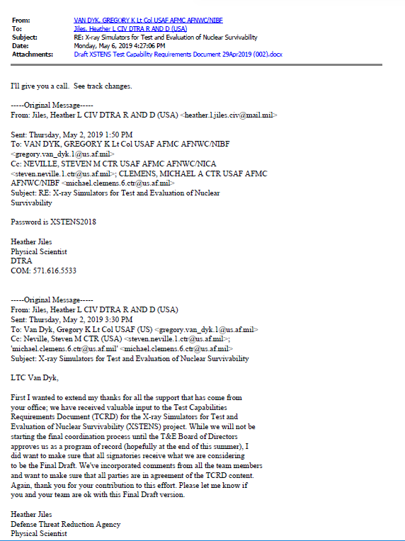
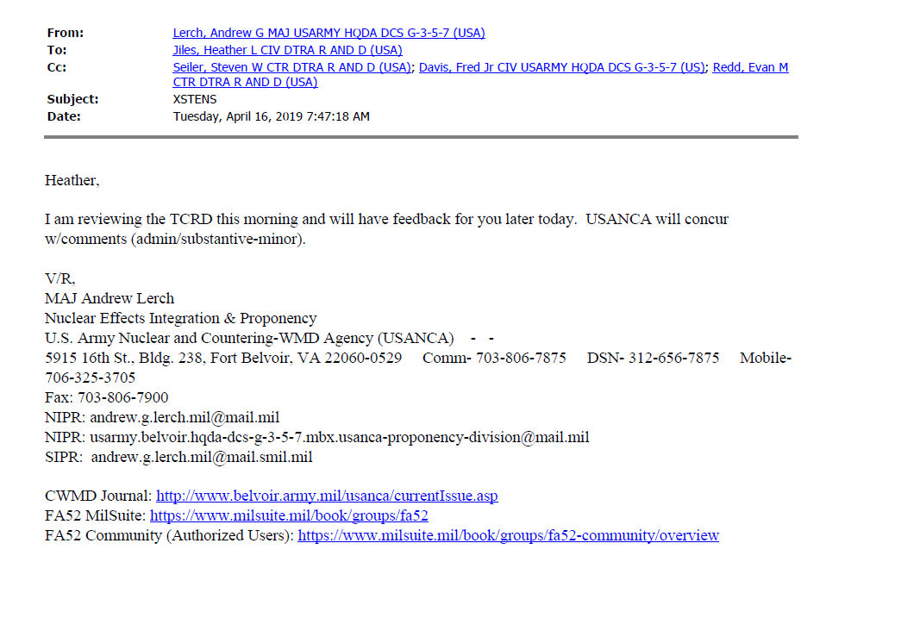
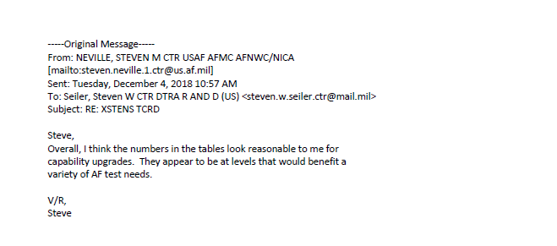
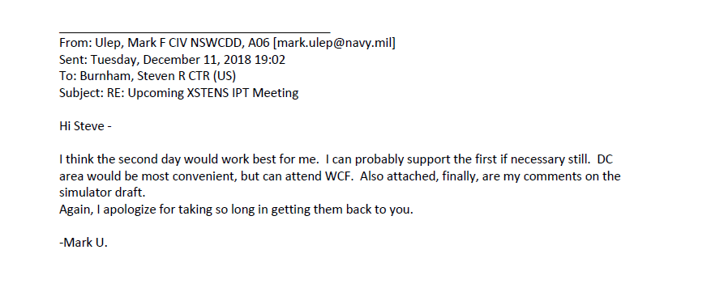
IPT and Stakeholder Engagements Quick Look
All images are UNCLASSIFIED//FOUO

Slide 36
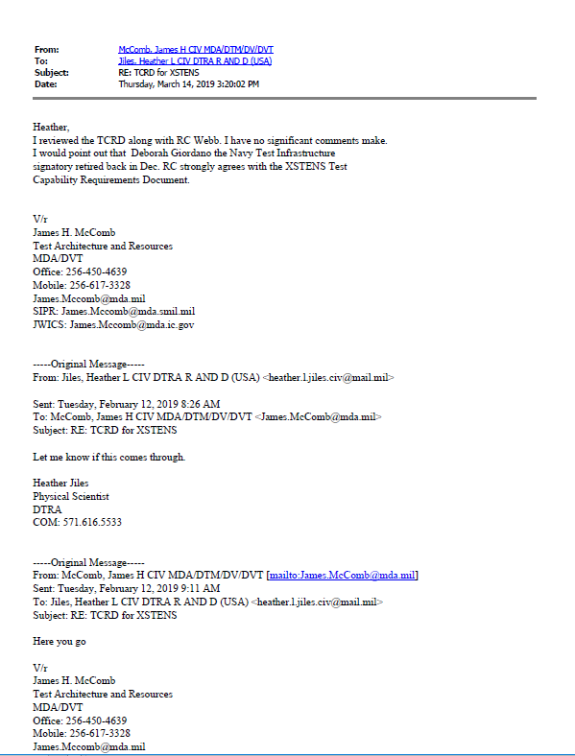
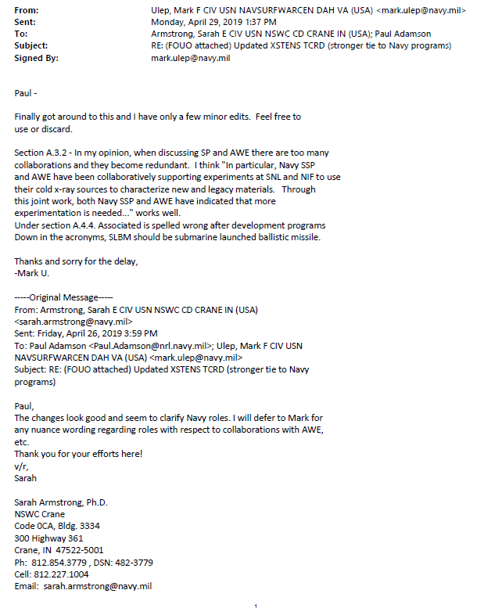
IPT and Stakeholder Engagements Quick Look
All images are UNCLASSIFIED//FOUO

Slide 37
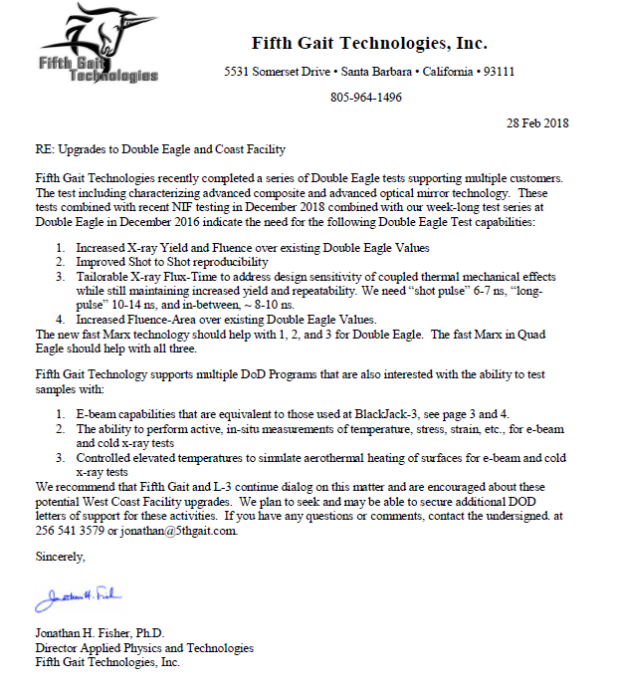
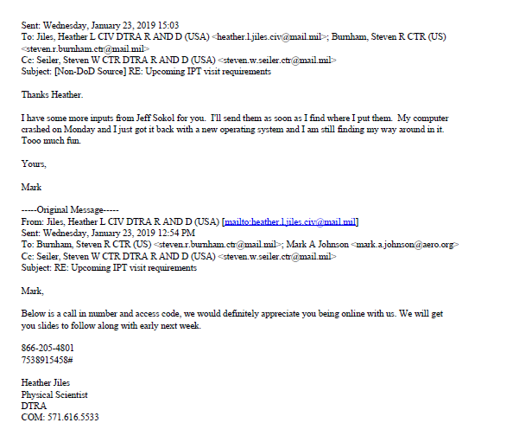
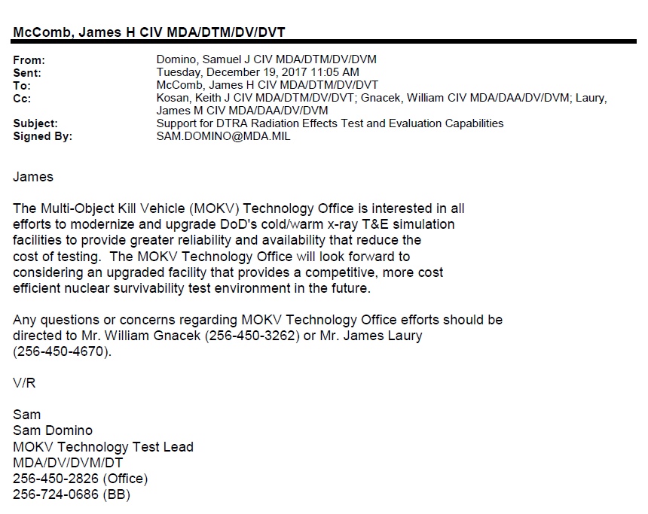
IPT and Stakeholder Engagements Quick Look
All images are UNCLASSIFIED//FOUO

Slide 38
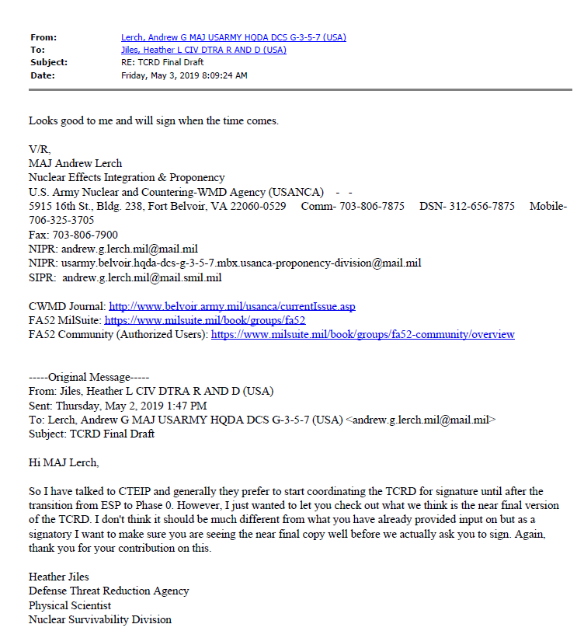
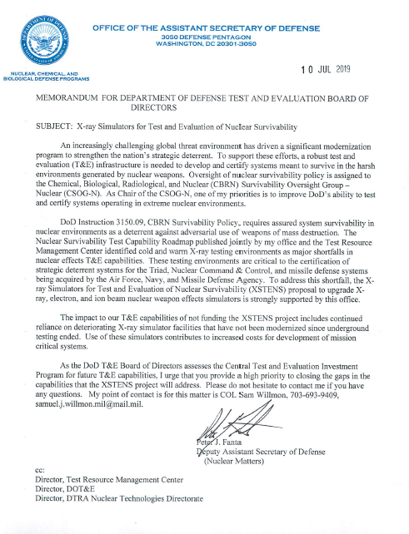
IPT and Stakeholder Engagements Quick Look
All images are UNCLASSIFIED//FOUO

Slide 39
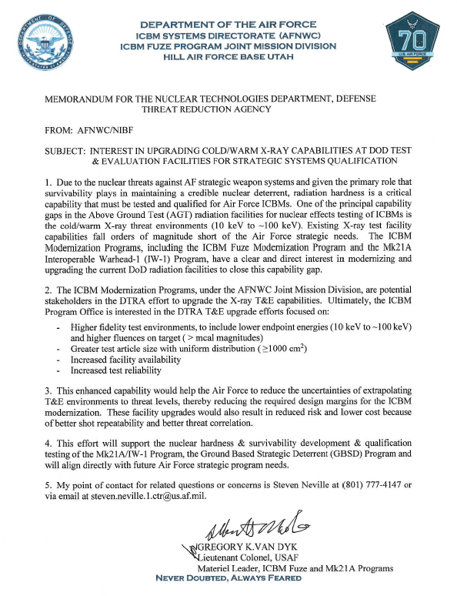
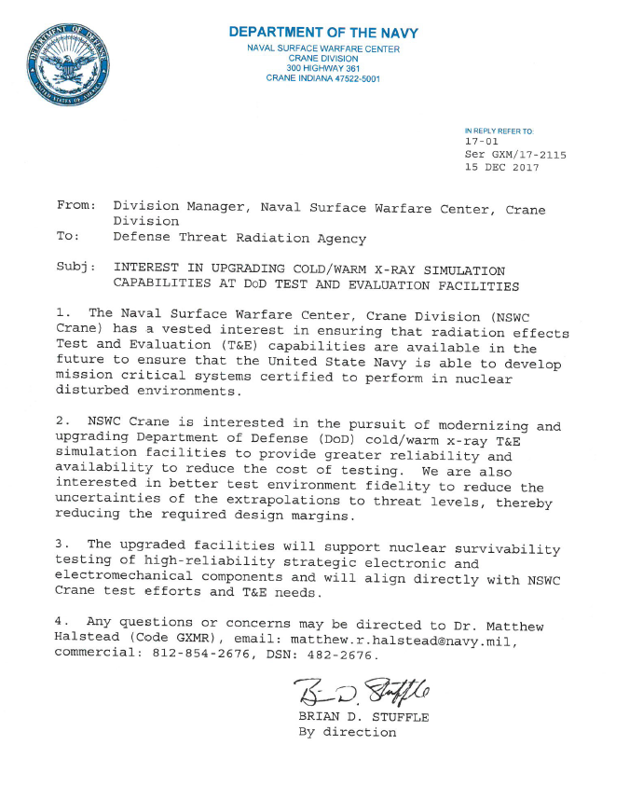
IPT and Stakeholder Engagements Quick Look
All images are UNCLASSIFIED//FOUO

Slide 40
Interceptor Component Test Scenario
UNCLASSIFIED//FOUO
XSTENS
Quad Eagle
Gamble III
PITHON II
Warm X-ray T&E
Debris Free Cold X-ray
High Fluence Cold X-ray
High Fluence Ion Beams
High Fluence E-Beams
Thermomechanical model validation and component certification for strategic systems such as reentry vehicles
System generated EMP model validation & component certification in strategic systems
T&E for Satellite and MDA electronics
Optical component testing on Interceptors & satellites
Optical subsystem testing for Interceptors & satellites
X-ray response characteristics of surface materials for strategic systems such as reentry vehicles
Structural material T&E and model validation for strategic system aeroshell materials, mounts, moveable structures, etc.
3-D component response and operability to blow-off impulse threats
Impulse response and shock propagation characterization of strategic system surfaces

Slide 41
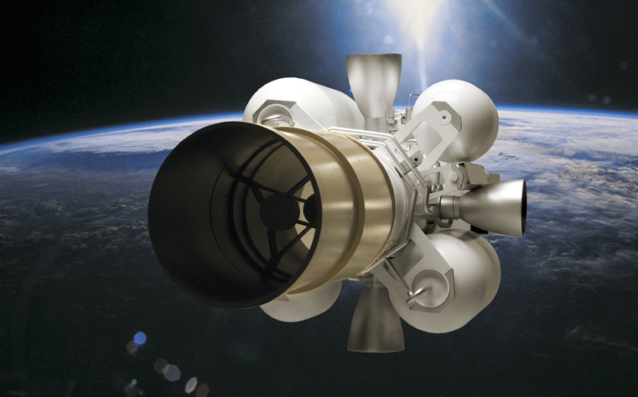
Interceptor Component Test Scenario
This graphic is UNCLASSIFIED//FOUO
Nuclear Engagement exposes KV to damaging photons
KV Attempts to track and ID enemy weapon
KV adjusts position to eliminate target
KV separates from Interceptor
Weapon and Decoys Released
Continuous technology upgrades needs survivability verification tests
Redesigned Kill Vehicle (KV)
Multiple Object KV
Interceptor Launched
Threat Missile Launched
“One of the challenges faced by MDA [Missile Defense Agency] is the need for survivable optical components. A multi-layer coating on a mirror may be damaged by X-ray exposure, vibration in the system can impair identification of a target, and material blown off of baffles onto the mirror can obscure a scene.” - Defense Science Board (DSB), Final Report on Nuclear Weapon Effects Test, Evaluation, and Simulation, April 2005. (UNCLASSIFIED)

Slide 42
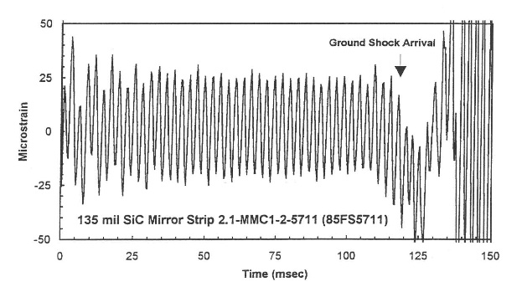
Interceptor Component Test Scenario Determining KPPs and KSAs
PRS X-ray yield and debris
Filtered cold photons
UNCLASSIFIED//FOUO
Test Scenario
User Objective: Determine degradation of optical component in nuclear environment and subsequent impact to mission
Simulator Objective: Provide relevant and reproducible environment i.e., x-ray yield, pulse width, fluence, etc
User Parameters: Multiple reproducible cold x-ray shots in debris free environment needed to characterize material and collect data for component verification and model validation.
User Test:
Full scale coating/substrate performance verification
Mirror Deformation performance
Manufacturability/Repeatability verification
Provides full and partial illumination performance
Full-Scale Coated Optic from KV Telescope used for tracking target
Plasma radiation source (PRS) driven by pulse power
Filter to create debris-free environment
Provided by User
(U//FOUO) MDA has been developing Harden Mirror Technology for VIS/IR Sensor Payloads during the last decade, full scale mirror tests needed to verify design
All images are UNCLASSIFIED//FOUO

Slide 43
Interceptor Component Test Scenario Determining KPPs and KSAs
Driven by physics environment but limited by technology
UNCLASSIFIED//FOUO
Attribute | Threshold | Objective | Current
KPP: PRS Yield of X-rays >3 keV | 40 kJ | 80 kJ | 20 kJ
KPP: PRS Line-of-Sight Access for Diagnostics and Test Articles | PRS viewable within 10° of normal to the Z axis at the center of the x-ray source at up to 3 meters in at least 4 azimuthal directions | PRS viewable within 10° of normal to the Z axis at the center of the x-ray source at up to 3 meters in 8 azimuthal directions | PRS viewable within 10° of normal to the Z axis at the center of the x-ray source at up to 3 meters in 3 azimuthal directions
KPP: Cold X-ray Quality Metric | 80% of shots within ±15% of intended output level | 90% of shots within ±15% of intended output level | 60% of shots are within ±15% of intended output level
KSA: Cold X-ray Pulse Width | >7 ns FWHM | >20 ns FWHM | 7-10 ns FWHM
KSA: Cold X-ray Shot Rate | 8 good shots/week | 10 good shots/week | 5 good shots/week
KSA: Cold X-ray Cost per Good Shot | $13K | $10K | $22K
Driven by user test requirements/needs for characterization and model validation but bounded by technology
(U//FOUO) Driving Assumptions for Test Scenario: (1) Future missile defense vehicles will require nuclear survivability certification and significant testing will be needed during the development process; (2) Low Earth Orbit Space Tracking and Surveillance System satellites will have coated optical components and solar arrays with nuclear survivability requirements; (3) Future satellite communications systems will have optical data links with coated optics and solar arrays that may require survivability certification.
An optic from a KV was used to demonstrate this test scenario; however, antenna arrays, radar windows, or any number of components from satellites or interceptors could be used.

